Slide 1
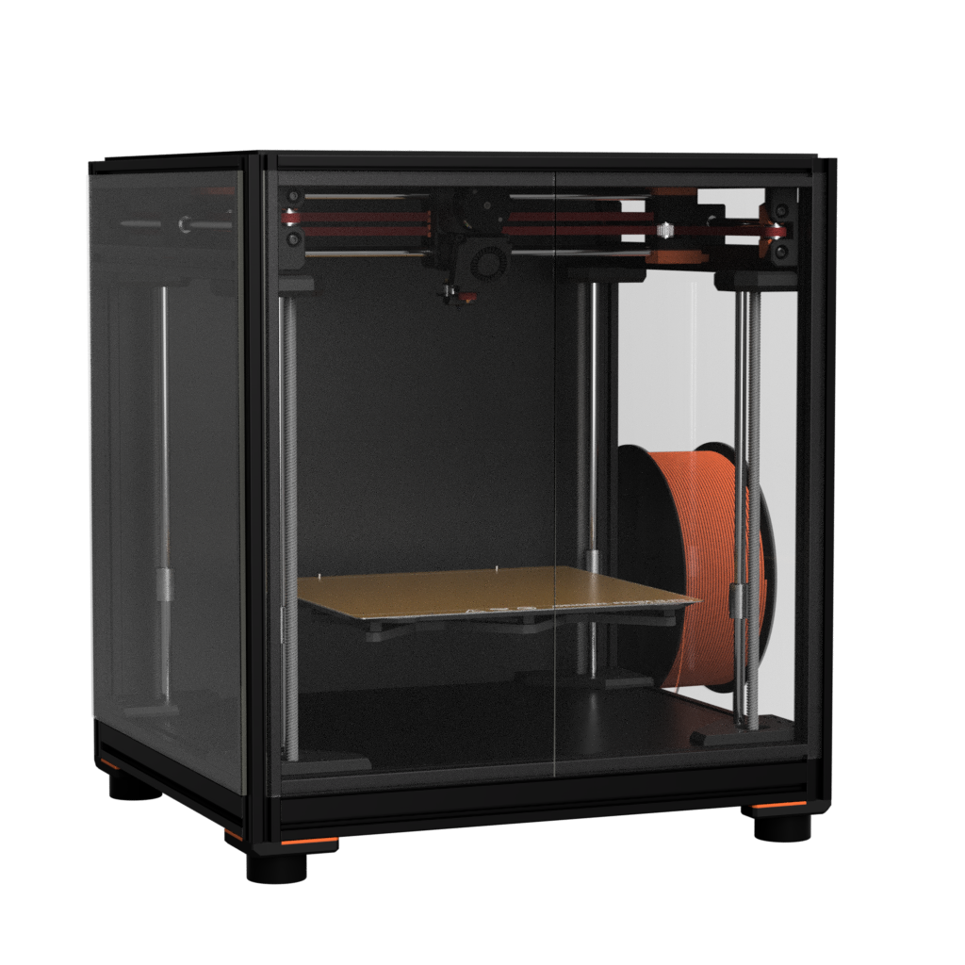
Satsuma 250
by Ella Fox
Assembly Manual
Version 2024-05-16

Slide 2

Introduction
Before you begin, a word of caution.
In the comfort of your own home, you are about to assemble a robot. This machine can maim, burn, and electrocute you if you are not careful.
Please apply common sense when operating your Satsuma, and do not hesitate to ask for assistance with assembly or usage of your machine.
Before starting your build, continue to read the manual in full.

Slide 3
About
The Satsuma 250 follows in the line of printers by Squirrelbrain. It takes design queues from the Satsuma 180.
The goal of this project is to re-imagine a Prusa MK3/MK4 as a CoreXY machine, whilst using much of the same components found in the original printers.
Whilst many of the mechanical parts can be sourced directly from Prusa, the whole the bill of materials can also be sourced from elsewhere with relative ease.
I hope you enjoy your build as much as I did putting this together <3
- Ella Fox

Slide 4






Credits
Special thanks to these awesome people, communities, and companies for making Satsuma 250 possible <3

Slide 5
Printed Part Guidelines
Depending on your goals for the printer, the material you choose to print the parts from will vary. Please use the table to configure your slicer settings accordingly.
Material | Minimum (Open Frame): PETG Recommended (Enclosed): ABS, ASA Premium (Enclosed, High Temperature): Annealed PC-CF
Nozzle | 0.4mm or 0.5mm
Layer Height | 0.2mm
Perimeter/Wall Count | 4
Solid Top/Bottom Layers | 5
Infill Percentage | Minimum: 30% Recommended: 40%
Infill Pattern | Grid
Extrusion Width | 0.4mm nozzle: 0.4mm forced width 0.5mm nozzle: 0.5mm forced width

Slide 6
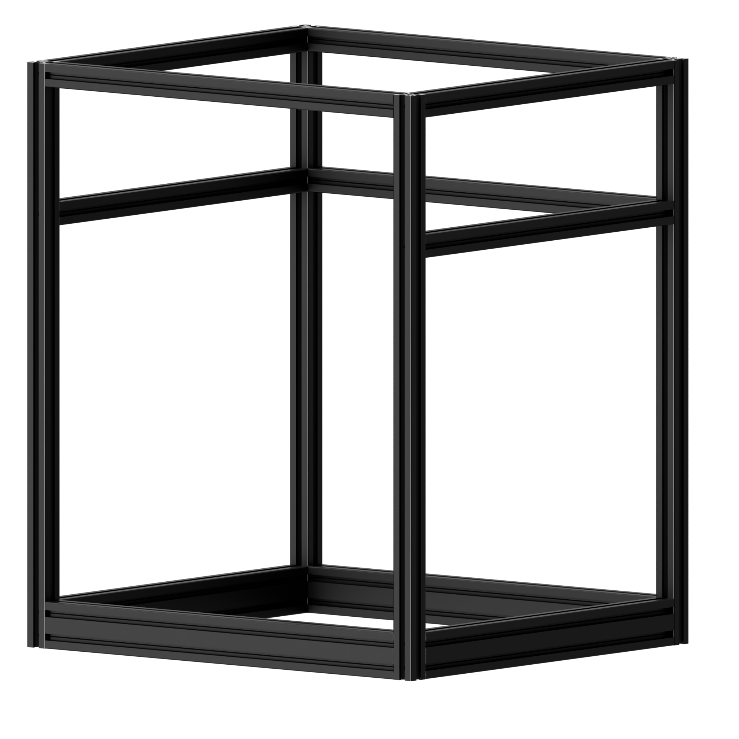
Frame

Slide 7



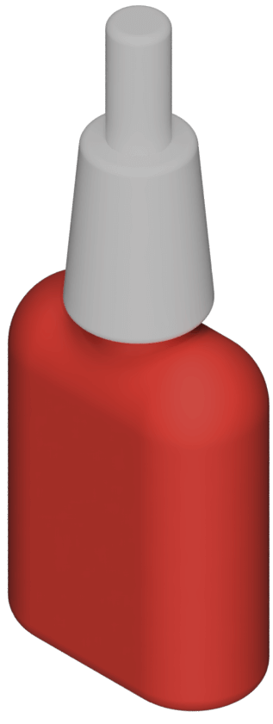
Preparation
Sort Extrusions
Fasteners
A Extrusion
20x20x500mm
Start by collecting all of your frame pieces, sorting them by the lengths. You can optionally use painter’s tape and a marker pen to label each piece by the letter assigned.
Find the M5x16 button head screws, and have medium strength thread locker on standby.
You will be using a 3mm hex wrench for the next step.
B Extrusion 20x40x380mm
C Extrusion
20x20x380mm
D Extrusion
20x40x335mm
E Extrusion
20x20x335mm
M5x16 BHCS
30 pieces
Thread
Locker

